Slide 1

Goal
Flight Price Prediction
Forecast flight prices
Selecting optimum time for travel
Selecting the cheapest flight to the desired destination
Submitted by:
Prashant Pathak

Slide 2

Scraping
Source & Destination
Date
Price
Duration
Total Stops
Airline

Slide 3

Scraped Routes
SVO
NYC
PAR
RUH

Slide 4

Steps of EDA
Importing necessary libraries
Loading Scraped data
Defining function to clean the data
Studying outliers and then deal with outliers
Check the null values
Handling categorical data
Drop unusual data
Creating final data frame for process
Our new data frame has 50097 rows and 10 columns
Name of columns is

Slide 5

Steps of EDA
Heatmap and plotting graph for finding relation between features and targeted variable

Slide 6
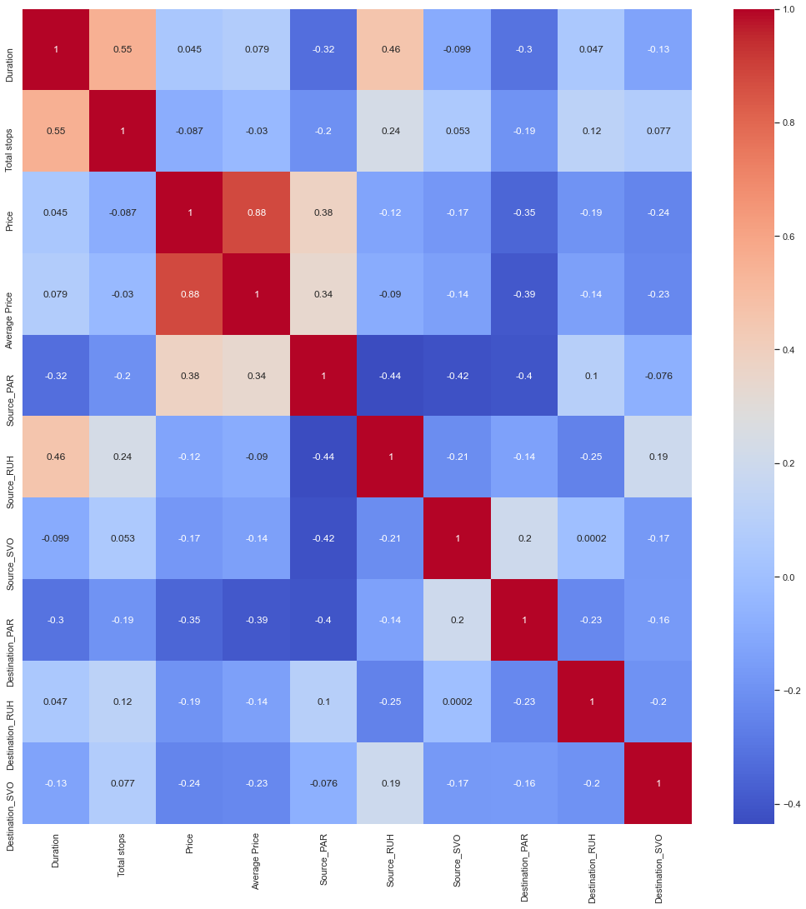

Slide 7
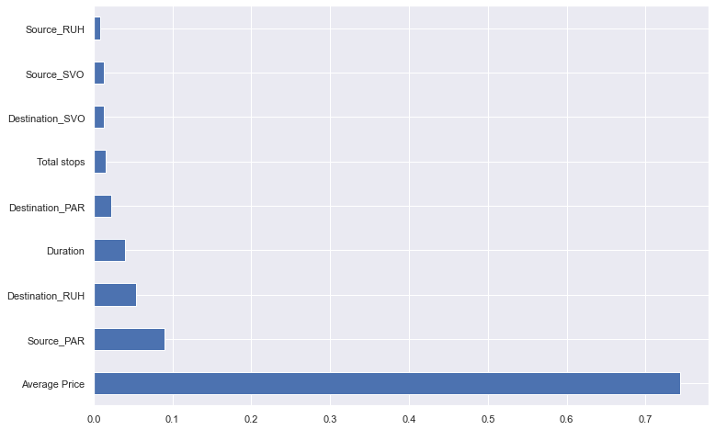

Slide 8
Steps of Modeling
Splitting
Splitting the data
Defining
Defining a function to get metrics for val set
Training and testing
Training and testing of many models

Slide 9

Result of models

Slide 10
LR Train score 0.8040357223322144 Val score 0.7891035984538433 MAE: 225.09235539537684 MSE: 152995.68380136567 RMSE: 391.146626984518
Lasso Train score 0.8040183311451377 Val score 0.7891286832351017 MAE: 224.60280304137635 MSE: 152977.48594102522 RMSE: 391.12336409504513

Slide 11
Ridge Train score 0.8040357214700532 Val score 0.7891039650109529 MAE: 225.0937616466228 MSE: 152995.41788096476 RMSE: 391.14628706018004
ElasticNet Train score 0.7354476290670592 Val score 0.7243019152118472 MAE: 304.4466319557438 MSE: 200006.3381624778 RMSE: 447.2206817248927

Slide 12
Random Forest Train score -1.0693924886375732 Val score -1.0832919574956343 MAE: 885.6332189325535 MSE: 1511332.9353093393 RMSE: 1229.362816791422

Slide 13

Final Model Selection
From the above analysis, we can see that the random forest model performed the best with:
Train score 0.9648778537711422
Val score 0.9448134490695079
MAE: 61.717733027545194
MSE: 40035.31608101726
RMSE: 200.0882707232417
So, we'll select it as our model

